Slide 1
Auto-ComPAnIon: Auto Supply Shop Inventory System with Predictive AI
Bolante, Shekinah D.
Dalisay, Mary Richalene
Ladringan, Jerdelyne R.
Saldua, Louezethe Ian Illicir N.

Slide 2
Project Overview
System Description: Auto-ComPAnIon is a computerized system that integrates Point-of-Sale (POS), Inventory Management, and Predictive AI module to digitize and streamline the operations of Santosidad Auto Supply.
Problem Being Solved: The system addresses inefficiencies caused by manual processes, including stock mismanagement, slow transaction processing, and the absence of data-driven decision-making tools.
Client and Target Users: The primary client is Santosidad Auto Supply, with target users including the Owner, Secretary, and Employees, each assigned role-based access and functionalities.
Key Features: The system provides centralized inventory tracking, automated sales transactions with approval workflows, and AI-driven analytics such as demand forecasting, ROI, and Reorder predictions to support operational and strategic decisions.

Slide 3
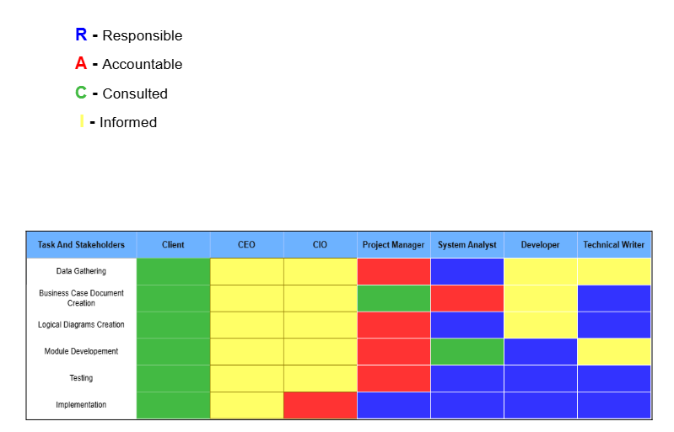
Project Team and Required Tasks
Table 3. RACI Matix

Slide 4
Current Business and Technical Situations
What is the current issue? The shop relies on manual recording for inventory and sales, making processes prone to errors.
Why is it important? These inefficiencies lead to inaccurate stock levels and limit the ability to make smart business decisions.
Who is affected? The Owner, Secretary, and Employees are affected as they handle daily operations using manual methods, clients are affected as well with inaccurate stock information and delayed availability of products, resulting in reduced service efficiency and customer dissatisfaction.
What problem are we solving? The lack of a digital system prevents efficient operations, proper inventory management, and data-driven decision-making.

Slide 5
Proposed Current and Technical Situations
To solve the inefficiencies of manual operations, Auto-ComPAnIon introduces a fully digital system that combines Point-of-Sale, Inventory Management, and Predictive AI in one platform. It replaces handwritten records with a centralized database, enabling real-time inventory tracking, faster transactions, and more accurate data management. Designed as a desktop-based system using a local server, it remains practical and accessible without requiring additional hardware investment. With built-in analytics like demand forecasting and profit prediction, the system empowers the business to make faster, smarter, and more informed decisions.

Slide 6
Objectives
General Objective
To develop a digital system that streamlines inventory and sales operations while leveraging AI for smarter business decisions.
Specific Objectives
Digitize inventory tracking through a centralized database.
Automate sales transactions and receipt generation.
Enable forecasting and data-driven insights using AI.

Slide 7
Benefits and Impact
Key Users | Impact and Benefits
Owner | Gains full view of sales, inventory, and analytics, enabling faster and more informed decision-making.
Secretary | Streamlines inventory updates and transactions recording, reducing manual workload.
Employee | Process sales and reduces operational errors.
Warehouse Staffs | Improves stock monitoring and organization, timely restocking and better inventory control.
Customers | Experience accurate product availability and improved overall service quality.

Slide 8
Project Milestones
Date | Activity | Status
March 31 – April 24 | Finishing Design Conceptualization | Done
April 3 – April 18 | Development & Testing | Done
April 17 – April 23 | Development & Testing 2.0 | Done
April 20 – April 27 | Final Report Documentation | Done

Slide 9
Constraints Analysis
Problems Encountered | Resolutions
Limited flexibility from open-source Java-based system | Rebuilt system structure and UI based on Figma design
Outdated Java Swing framework | Migrated to JavaFX for better UI flexibility
No guaranteed WiFi setup | Used localhost server via Flask for offline access
Required transaction approval by Owner | Added Pending Transactions with approval workflow
Tablets not a priority for client | Shifted to desktop-based system deployment
Bright warehouse environment affecting visibility | Applied high-contrast UI for better readability

Slide 10
System Features
Module | Description | Intended Users per Module
User Authentication | Authenticates users and allows them to access the system. | All Authenticated Users
Inventory Management | handles stock management through sub-modules that notify of stock out, allow the user to search and edit the stock levels. | Owner & Secretary (Full Access), Employee (View Only)
Point of Sale | Handles transactions, which includes payments, digital receipts and refunds. | All Authenticated Users
Predictive Artificial Intelligence | Offers business intelligence for sales forecasting, including seasonal stock recommendations, revenue growth forecasts, and price recommendations. | Owner & Secretary Only

Slide 11
AI / Data Analytics Utilization
Predictive Artificial Intelligence
Auto-ComPAnIon leverages AI-driven analytics to transform raw business data into actionable insights for better decision-making. It supports sales forecasting, seasonal stock recommendations, revenue growth projections, and pricing insights, enabling the business to anticipate demand rather than react to it. By analyzing historical sales patterns and operational trends, the system helps optimize inventory levels, improve profitability, and reduce stock inefficiencies. This ensures that Santosidad Auto Supply can make faster, smarter, and data-driven business decisions with confidence.

Slide 12
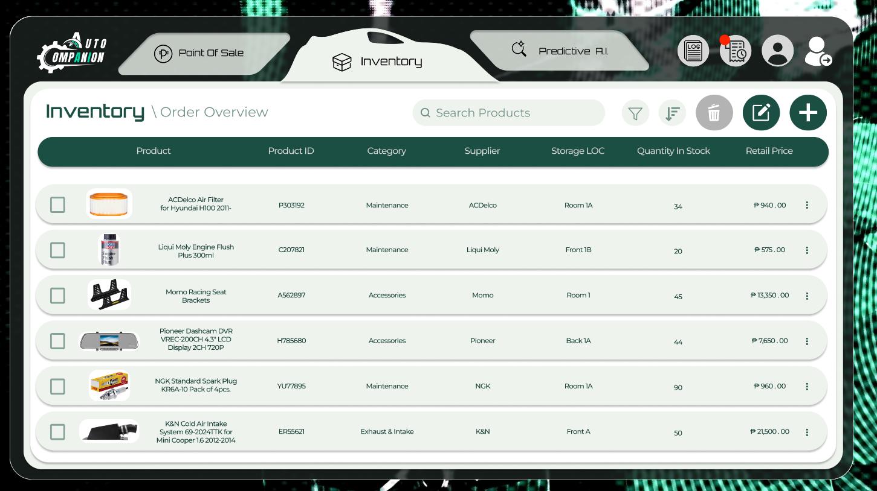
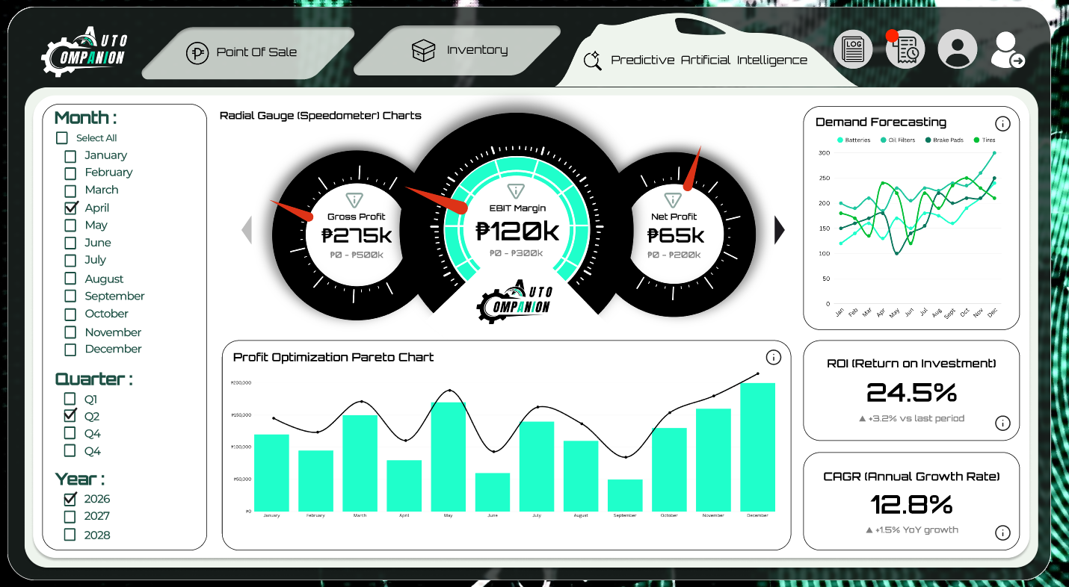
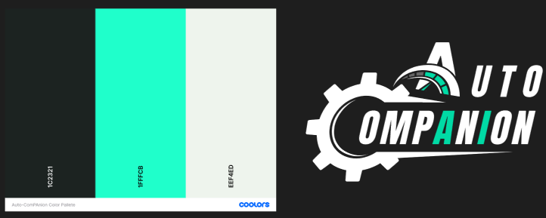
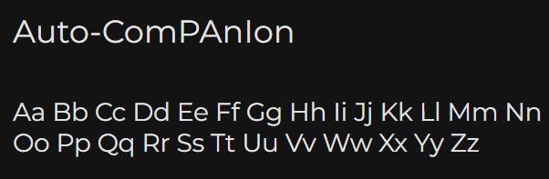
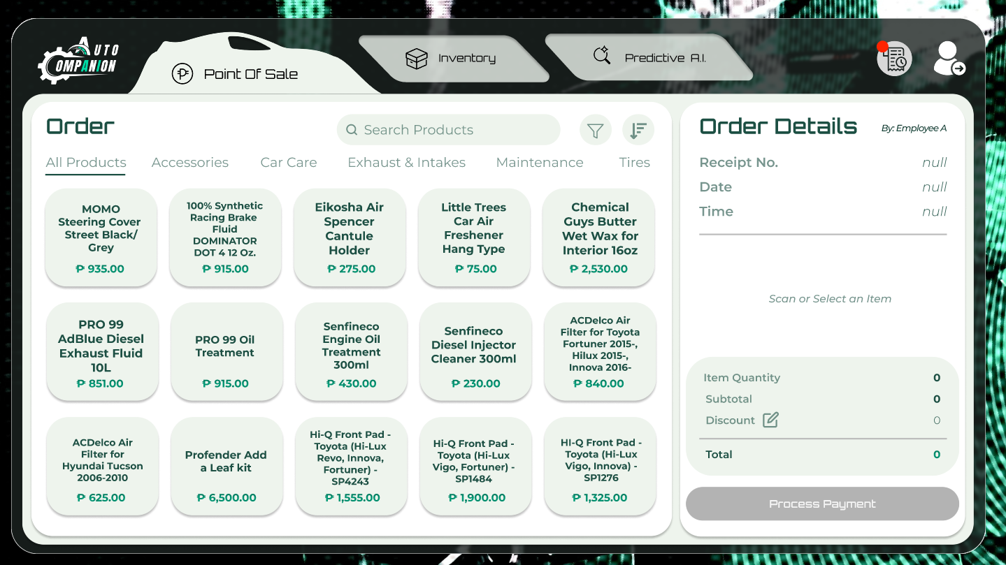


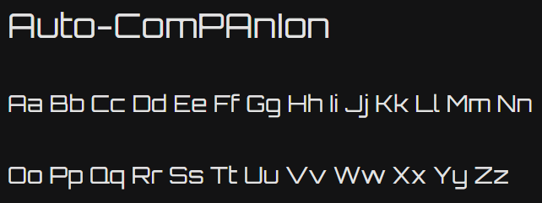
User Interface

Slide 13
Testing
Key Activity | Results | Status
Unit Testing | All modules were probed with invalid and incomplete data inputs and all returned with the expected error handling. | Complete
Integration Testing | Access to each individual module was proven to be role dependent and secure. | Complete
System Testing | The backup and recovery capabilities were tested and showed that it was supported but lacks full operational readiness and verification. | In Progress
User Acceptance Testing | Overall, the results of the User Acceptance Testing indicate that Auto-ComPAnIon is a reliable and user-friendly system that meets the client’s expectations while allowing room for continuous improvements. | Complete

Slide 14
Product Demonstration

Slide 15
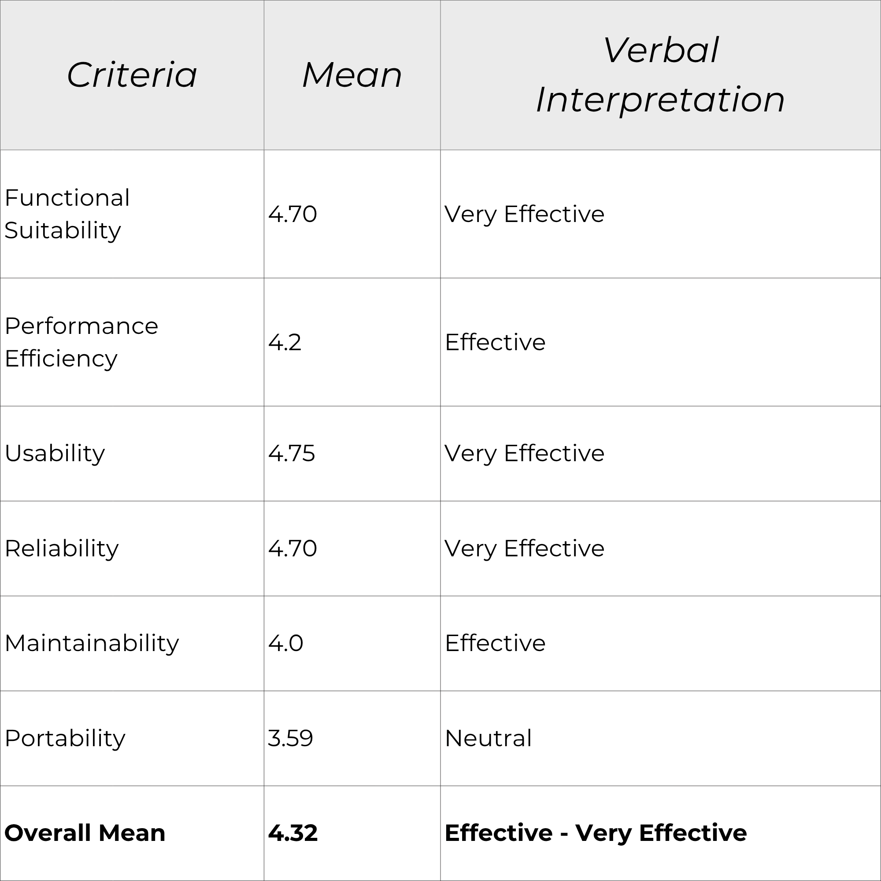
Users’ Evaluation
During the product demonstration of
Auto-ComPAnIon, the client expressed positive feedback, particularly valuing the shift from manual transaction logging to a digitalized POS and Inventory system with predictive features. The system achieved an overall mean score of 4.32 based on an ISO 25010 model, indicating an Effective to Very Effective level across key quality attributes. This suggests that the system is reliable, user-friendly, and functionally suitable for improving their operational efficiency.

Slide 16
Future Enhancements
1. Quality of Life Improvements
Implementation of auto-fill features for repetitive inputs in business logs
Addition of status tracking for purchase orders to improve workflow visibility.
2. Confidence Score
Introduction of a metric that indicates the reliability or confidence level of AI-generated predictions.
3. Prediction Accuracy Assessment
Development of a feature to compare predicted values against actual outcomes to evaluate model performance.
4. AI Model Enhancement
Transition from a regression-based model to a reinforcement learning approach to improve adaptability and prediction accuracy over time.

Slide 17
Conclusion
Auto-ComPAnIon successfully integrates POS, inventory management, and predictive analytics into a unified system designed for an auto supply shop. It enhances operational efficiency while enabling data-driven decision-making.
Moving forward, continued improvements and exploration of advanced AI capabilities will further strengthen its role as a valuable business tool.

Slide 18
Questions?

Slide 19
Thank you!

